Slide 1


eQMS
electronic
Quality
Management
System
Born from Pharma, built for everyone

Slide 2

What is CosmoVault?
A complete electronic Quality Management System (eQMS) for quality-driven companies
Documents, training, change control, deviations and complaints in one platform
A secure vault for batch data, controlled and signed PDFs, with long-term storage
Ensures data integrity, full traceability and auditability designed to align with EU Annex 11 and FDA 21 CFR Part 11
Secure collaboration with partners and suppliers through controlled access
Notes:
2

Slide 3
CosmoVault is designed for:
Quality Assurance & Quality Control Departments
Responsible for document control, deviations and audit readiness
Production & Operations Teams
Following approved procedures and reporting changes and deviations
HR & Training Coordinators
Planning trainings and keeping complete training records
Regulatory Affairs & Compliance Departments
Managing approvals, changes and inspection readiness
External Partners & Suppliers
Requiring controlled, permission-based access for collaboration

Slide 4
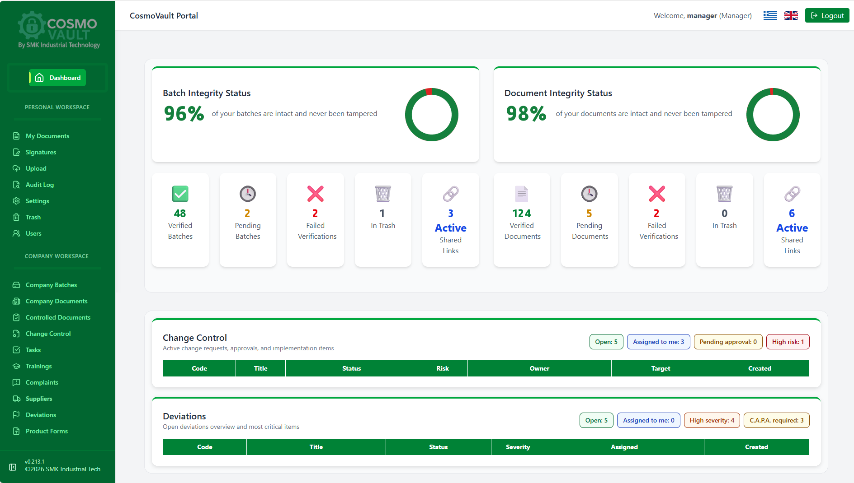
Modern Dashboard
Data integrity status at a glance
Open tasks, change controls and deviations
Key counters: open, assigned and high-risk items
All role-aware and user filtered

Slide 5
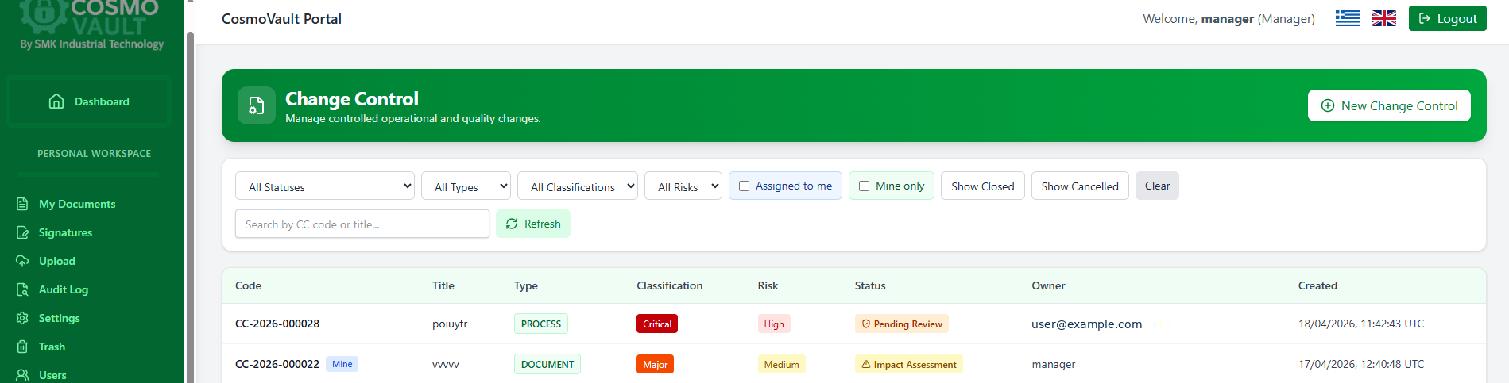
Quality Modules
Controlled Documents
Versioning, approval workflows and full document lifecycle
Trainings
Training plans, assignments, reminders and complete records
Change Control
From request and risk assessment to approval and implementation
Deviations
Recorded and investigated with clear status, severity and responsibility
Tasks & Complaints
Assigned, tracked and closed with due dates and full traceability
Supplier Qualification
Supplier evaluation with questionnaires completed by the supplier

Slide 6
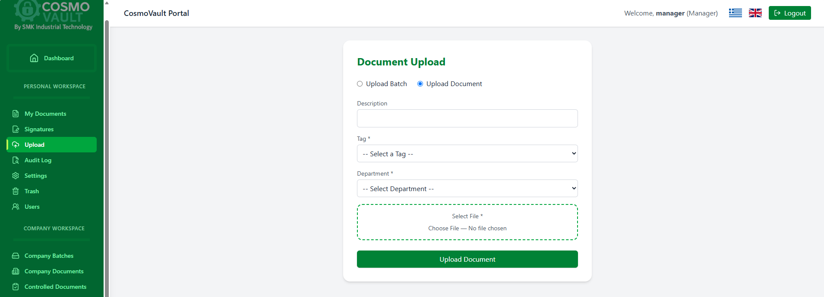
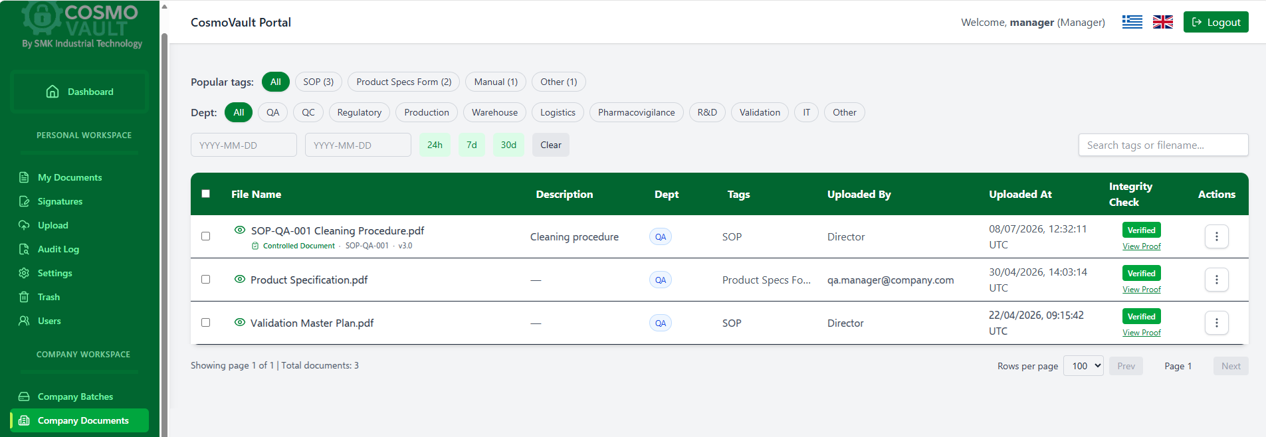
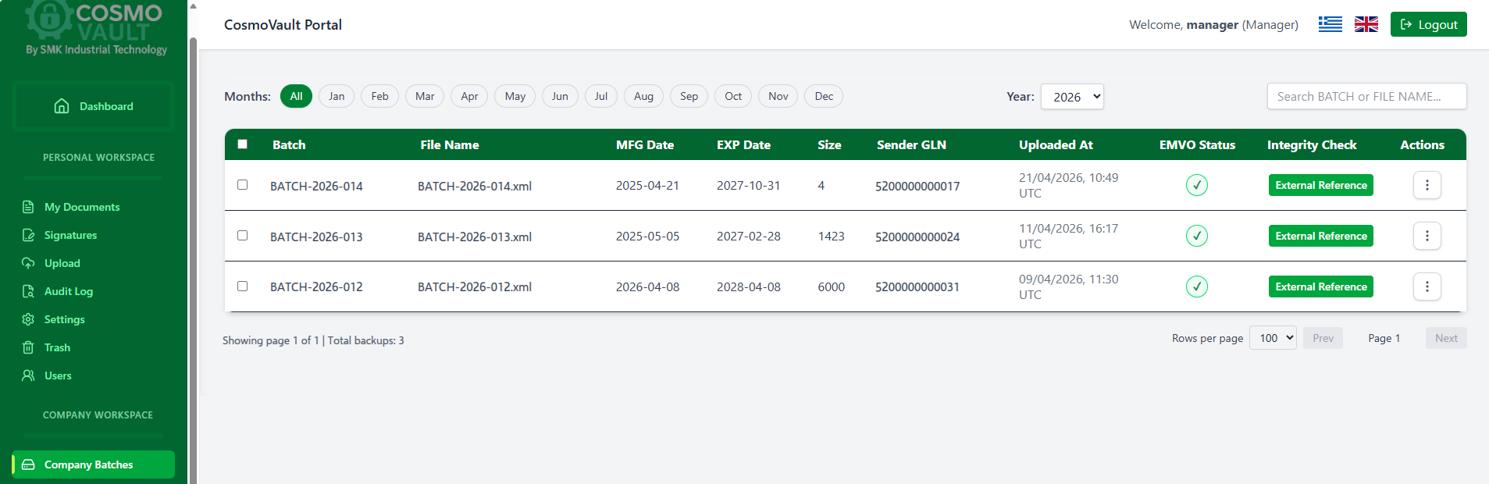
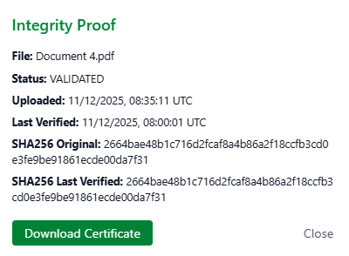
Batch Data and Document Management
Controlled batch records and document uploads
Time-limited external links, revocable at any time
PDF preview and version management
Periodic integrity verification of all stored data, following FDA 21 CFR Part 11 & EU Annex 11 guidelines
Metadata tracking with SHA-256 integrity checks

Slide 7
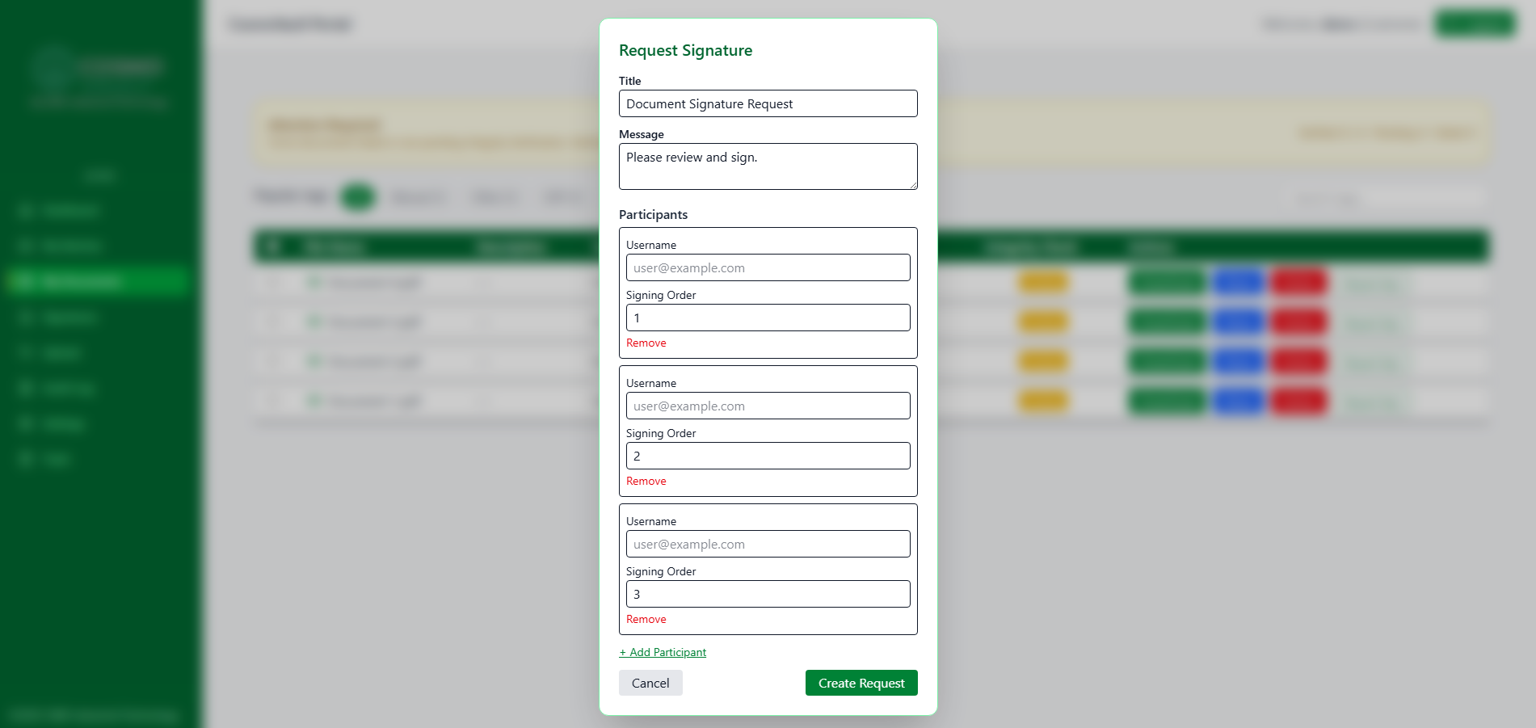

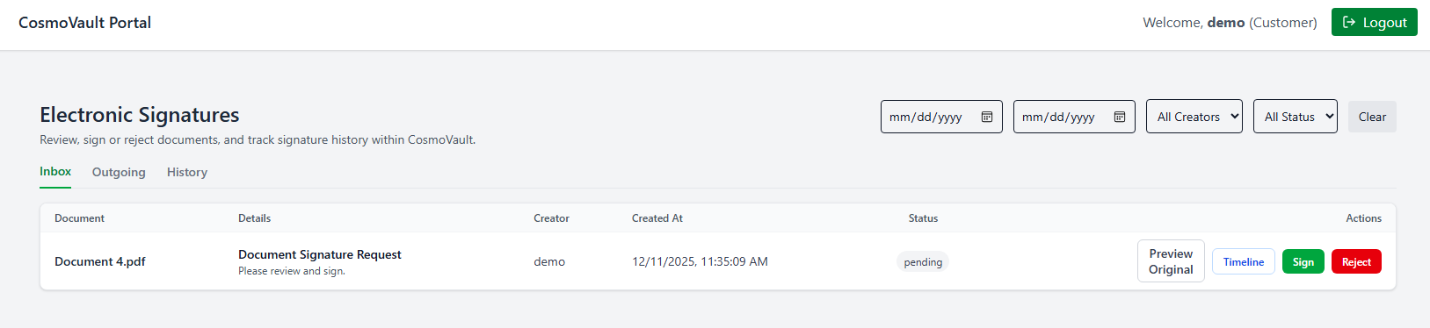
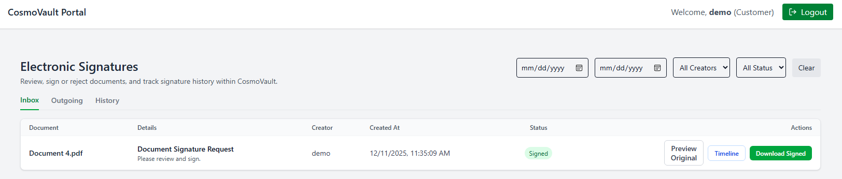
Electronic Signatures
Users sign directly within CosmoVault
Effortless signature requests for single or multiple participants
Signature blocks with user identity, timestamp and signature ID
Tamper-evident signed PDFs and audit-tracked signatures
Preview the original and download the signed PDF

Slide 8
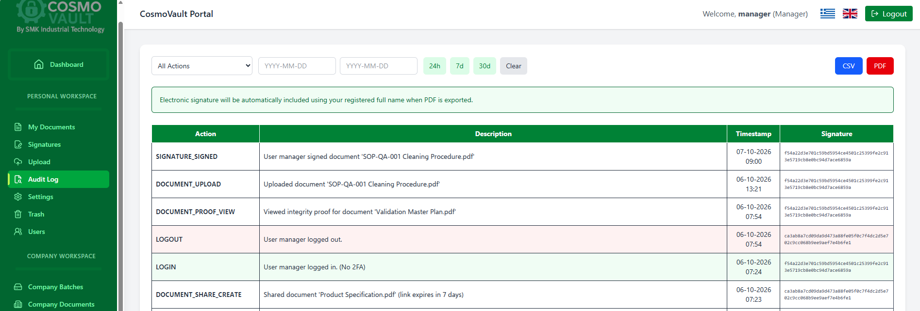
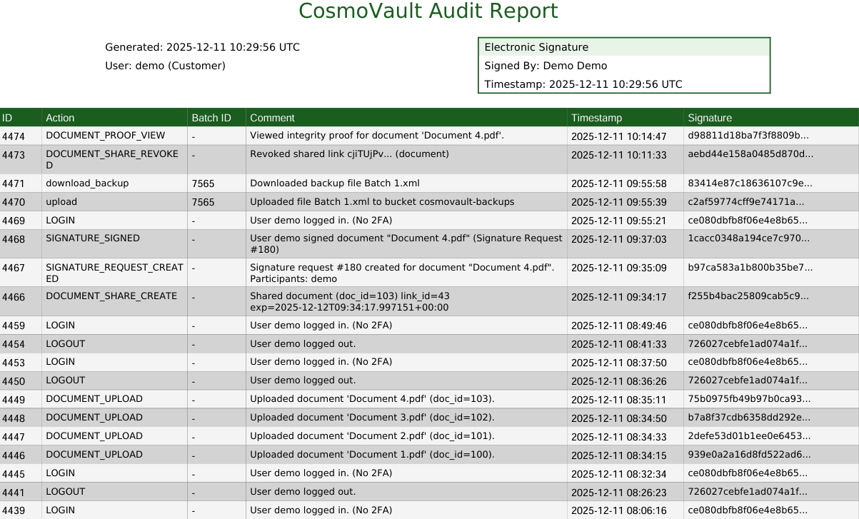
Audit Log
Every action is recorded:
Login, logout
Uploads, downloads
Document views
Signature events
Shared and revoked links
Changes in quality records
Exports audit logs as CSV or digitally signed PDF
Supports FDA 21 CFR Part 11 & EU Annex 11 traceability expectations

Slide 9

Contact us
info@smk-industrialtech.com
Tel. : +30 2106627334
www.smk-industrialtech.com
Thank you for your trust!

